Slide 1



Slide 2
TELECOM CHURN Analysis
PYANSHU SHAW MANISH MISHRA
TOOLS : EXCEL, PYTHON, MySQL, POWERBI
DATE : 14-08-2025
Page 0 2

Slide 3
Content
Overview
Problem Statement
Data Understanding
Data Preparation
EDA
Insights & Findings
Recommendations
Conclusions
Page 0 3

Slide 4

OVERVIEW
Churn is a problem for telecom companies because it is more expensive to acquire a new customer than to keep your existing one from leaving.
Project objective
To identify Customer Churn.
The goal is to identify key factors contributing to customer churn that can help telecom companies improve customer retention strategies.
The project involves data cleaning and the application to extract meaningful information related to customer behavior, service usage, and contract features.
Page 0 4

Slide 5
PROBLEM STATEMENT Customer churn poses a significant financial risk to telecom companies. Using a structured customer dataset that includes demographics, service usage, billing details, and churn labels, this project aims to build a machine learning model to predict features which contribute significantly in churn customer.
Metric Affected | How It's Impacted
Revenue | Immediate drop from lost payments
Profitability | Higher CAC to replace lost users
CLV | Reduced as users leave earlier
Growth Rate | Slowed due to customer loss
Brand/Trust | Damaged perception and satisfaction
Page 0 5

Slide 6
Project understanding
Source dataset is in Multiple format (text, csv, xlsx).
Dataset contains 7044 rows and 24 columns.
There is 11 missing values in the Totalcharges column for the provided dataset.
Churn is the variable which notifies whether a particular customer is churned or not.
There is One unique identifier (CustomerId) assigned to each customer, Six numerical columns, Four categorical columns and Eleven Boolean columns.
Page 0 6

Slide 7
Project preparation
Handled Missing Values: Filled in missing data to ensure dataset completeness.
Removed Duplicates: Eliminated duplicate records to maintain data integrity.
Removed Columns: Dropped unnecessary columns containing no useful data (Senior citizens).
Created Age Group Column: Categorized customers into predefined age ranges from their date of birth for analysis.
Created Tenure Group Column: Grouped customers based on the number of months they have stayed.
Created Churn Status Column: Converted churn values to numeric format (Yes = 1, No = 0) for analysis and modeling.
Page 0 7

Slide 8
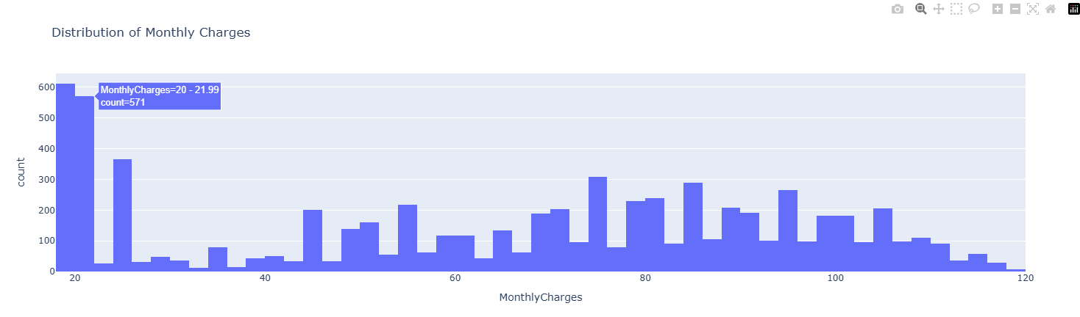
Exploratory data analysis (eda)
Most customers are on low-cost plans – The highest peak is in the ₹20–₹22 range, with 571 customers, suggesting many users choose cheaper plans.
Page 0 8

Slide 9
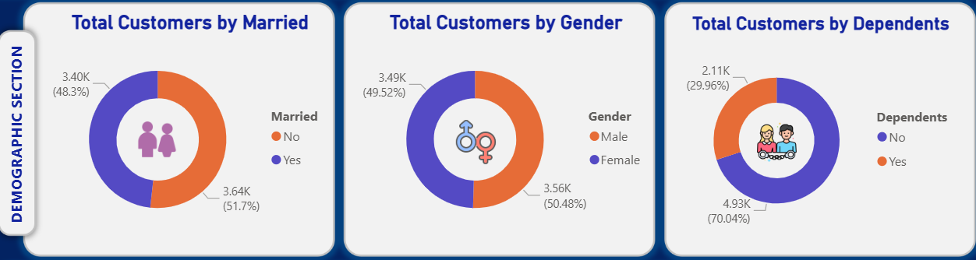
Married: 51.7% (3.64K)
Not Married: 48.3% (3.40K)
This suggests marital status alone might not strongly influence customer base size but could be relevant when paired with churn data.
Male: 50.48% (3.56K)
Female: 49.52% (3.49K)
Gender doesn’t seem to create major bias in customer numbers, indicating equal market penetration.
Without Dependents: 70.04% (4.93K)
With Dependents: 29.96% (2.11K)
Majority of customers do not have dependents, which could influence service usage patterns
Page 0 9

Slide 10
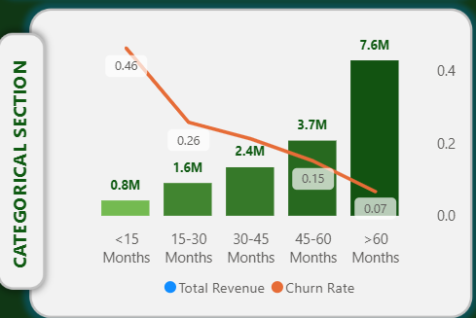
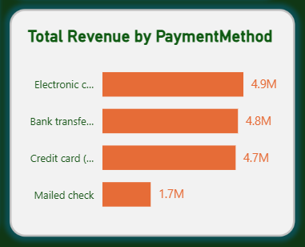
Customers & Total revenue by Tenure
Customers with <15 months tenure have the highest churn rate (46%) despite contributing 0.8M in revenue, which concludes Short tenure = High churn
Customers with >60 months tenure contribute the most revenue (7.6M) and have the lowest churn rate (7%), which implies that Long tenure = low churn
Mailed check is least preferred – only 1.7M in revenue, possibly due to inconvenience or slower processing.
Top 3 methods (Electronic Check – 4.9M, Bank Transfer – 4.8M, Credit Card – 4.7M) are almost equal in revenue.
Page 1 0

Slide 11
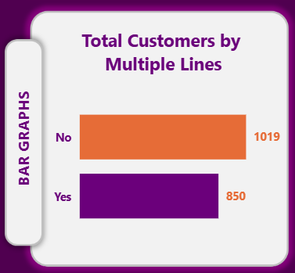
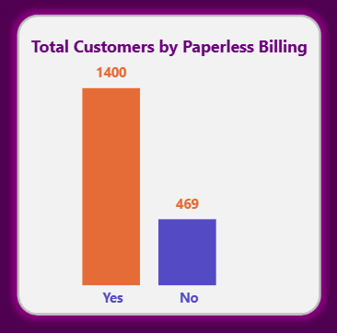
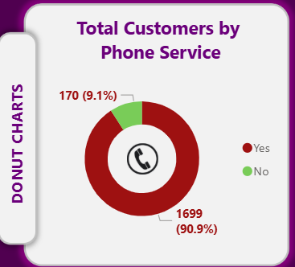
Customers using services where Churn is Yes
This suggests that upselling extra lines hasn’t necessarily increased loyalty.
This aligns with typical telecom patterns where paperless billing customers often have month-to-month contracts, making it easier to cancel.
Almost all churned customers had phone service, meaning having a phone line alone doesn’t prevent churn
This may indicate they value internet more than phone service, so losing internet satisfaction could lead to leaving altogether
Page 1 1

Slide 12
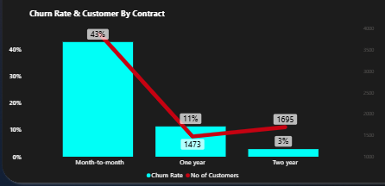
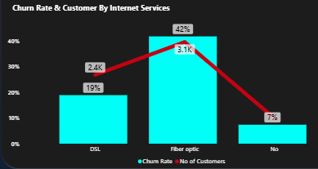
Customer & churn rate by contract & internet services
📊 Insight: Customers on month-to-month contracts have the highest churn rate (43%), compared to 11% for one-year and only 3% for two-year contracts. Despite having fewer customers (1,473 and 1,695), longer contracts clearly encourage customer retention.
🔍 Implication: Encouraging longer-term contracts could significantly reduce churn and improve customer stability.
📊 Insight: Customers using Fiber optic internet have the highest churn rate (42%), even though they represent the largest group (3.1K customers). In contrast, customers without internet service have a much lower churn rate (7%).
🔍 Implication: There may be issues with the fiber optic service quality or pricing, prompting customers to leave. This segment needs urgent attention to understand and resolve pain points.
Page 1 2

Slide 13
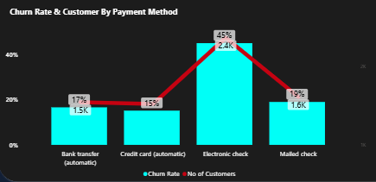
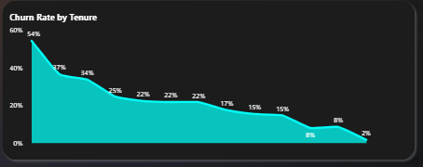
Customer & churn rate by payment method
📊 Insight: Customers who pay via electronic check exhibit the highest churn rate (45%), while those using credit card (15%) or bank transfer (17%) are less likely to churn.
🔍 Implication: Electronic check users might face payment difficulties or lack engagement. Promoting automatic or more convenient payment methods could help reduce churn.
📊 Insight:
Initial churn: 54%
After short tenure: Drops to 37%, then 34%
Mid-tenure range: Stabilizes at 22%–15%
Long-term tenure: Falls to 8%, then 2%
✅ Implication:
Churn decreases consistently with tenure. Early engagement is critical—retain customers early to build a loyal, low-churn base over time
Page 1 3

Slide 14
Correlation analysis with respect to churn
Variable | Correlation with Churn | Interpretation
Tenure | -0.3695 | Longer tenure → less likely to churn
Total Charges | -0.2318 | Higher total charges → less likely to churn
MonthlyCharges | +0.1847 | Higher monthly charges → slightly more likely to churn
Age | -0.0182 | Age not related to churn
Page 1 4

Slide 15
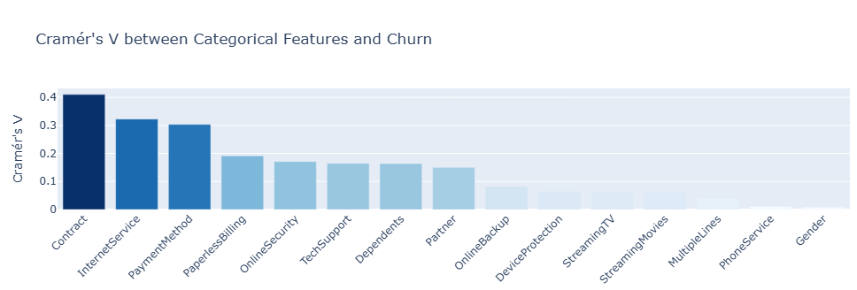
Correlation analysis with respect to churn
Feature | Cramér's V | Strength of Association
Contract | 0.41 | Strong
Internet Service | 0.32 | Moderate to strong
Payment Method | 0.30 | Moderate
Paperless Billing | 0.19 | Weak to moderate
Online Security | 0.17 | Weak to moderate
TechSupport | 0.16 | Weak to moderate
Dependents | 0.16 | Weak to moderate
Partner | 0.15 | Weak
Online Backup | 0.08 | Very weak
Device Protection | 0.07 | Very weak
Streaming TV | 0.06 | Very weak
Streaming Movies | 0.06 | Very weak
Multiple Lines | 0.04 | Negligible
Phone Service | 0.01 | Negligible
Gender | 0.01 | Negligible
Page 1 5

Slide 16
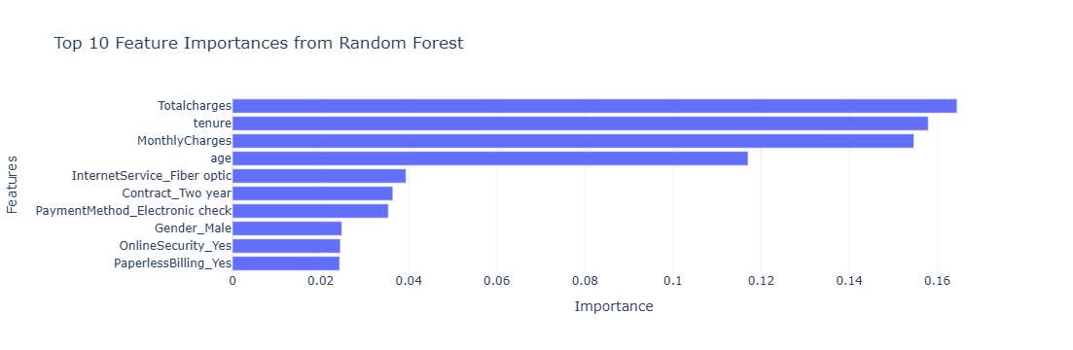
important features
Feature | Importance | Interpretation
Total charges | 0.164 | Strongest predictor of churn — customers with high total charges may be more likely to churn.
tenure | 0.158 | How long a customer has been with the company — shorter tenure might indicate higher churn risk.
Monthly Charges | 0.155 | Higher monthly charges could lead to dissatisfaction.
age | 0.117 | Older or younger customers might show different churn behaviour.
Internet Service | 0.039 | Customers with Fiber optic might have different satisfaction/churn rates.
Page 1 6

Slide 17
Insights & Finding
Overall Churn Rate : A significant portion of customers have churned (26.5%), highlighting the need for stronger customer retention strategies.
Service Usage Patterns : Customers using all services (phone, internet, backup, tech support, etc.) are more likely to stay.
Customer Demographics and Churn : Younger customers (age < 30) and older customers (65+) showed different churn behaviors, helping identify which age groups need better targeting.
Contract Type & Retention : Customers on long-term contracts (1 or 2 years) churn less compared to month-to-month, showing that longer commitments improve retention.
High-risk churn profile identified : Paperless billing + multiple lines + no support services = highest churn risk combination.
Page 1 7

Slide 18
Recommendation
In Internet Connection, Fiber optic customers are potentially high-value but also high-risk; improving service quality, pricing, or customer support in this segment could reduce churn significantly.
Since marital status and gender are balanced, the retention strategies might focus more on dependent status.
Retention strategies should focus on newer customers in their first 1–2 years to prevent early churn.
Customers using electronic checks may need extra attention, as past churn analysis often shows higher churn for this payment method.
Strategies to focus on customers without support and security services as they are more prone to churn.
Page 1 8

Slide 19
Conclusion In this telecommunication dataset analysis project, we aimed to extract meaningful insights from customer data to improve business performance, reduce churn, and enhance customer satisfaction. Our approach involved a combination of data preprocessing, exploratory data analysis (EDA), and predictive modelling.
Key Steps and Methods:
Data Preprocessing: Handled missing values, encoded categorical variables (using techniques like one-hot encoding), and normalized numerical features.
Exploratory Data Analysis: Visualized distributions and relationships using histogram, bar graph, pie chart, etc.
Key insights included :
Customers with month-to-month contracts had a significantly higher churn rate.
High monthly charges and low tenure were strong indicators of potential churn.
Customer service calls were positively correlated with dissatisfaction and churn.
Predictive Modeling:
Used Logistic Regression, Decision Trees, and Random Forests to identify churn customer top features.
Feature importance analysis revealed Totalcharges, contract, tenure, monthly charges, and internet service type as top predictors of churn.
Page 1 9

Slide 20

Page 2 0
DATE : 14-08-2025

